Slide 1

Rockbuster Stealth Analysis
Valentin Monnet - March 2024

Slide 2
Introduction
Rockbuster is engaged in the traditional video rental business, serving customers worldwide across six continents
Amid the rise of streaming platforms like Netflix and Amazon Prime, Rockbuster Stealth's executive team is strategizing to leverage its existing movie licenses by venturing into an online video rental service
This project aims to support the strategic launch of Rockbuster Stealth's new online video rental service.

Slide 3
Key Questions
What are the average rental duration for all videos?
Where are the Rockbuster customers?
Which countries have higher revenue?
In which cities do the customers live?
Who are the top customers?
Which genres are the most representative?
What are the next steps for Rockbuster?

Slide 4
Rockbuster Stealth Overview
1 000 unique films
Only one language : English
17 genres
599 customers
Rental duration : Average 5 days/Min 3 days/ Max 7 days
Length: Average 115mins/ Min 46 mins/ Max 186 mins

Slide 5
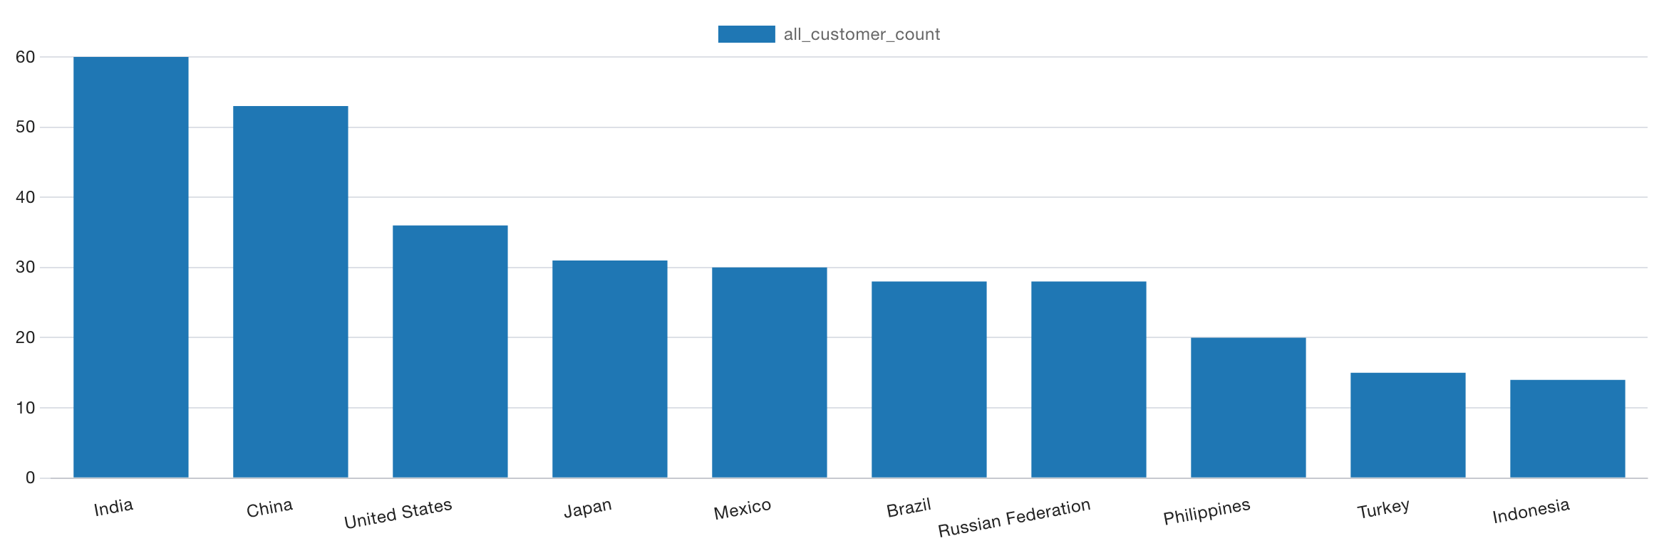
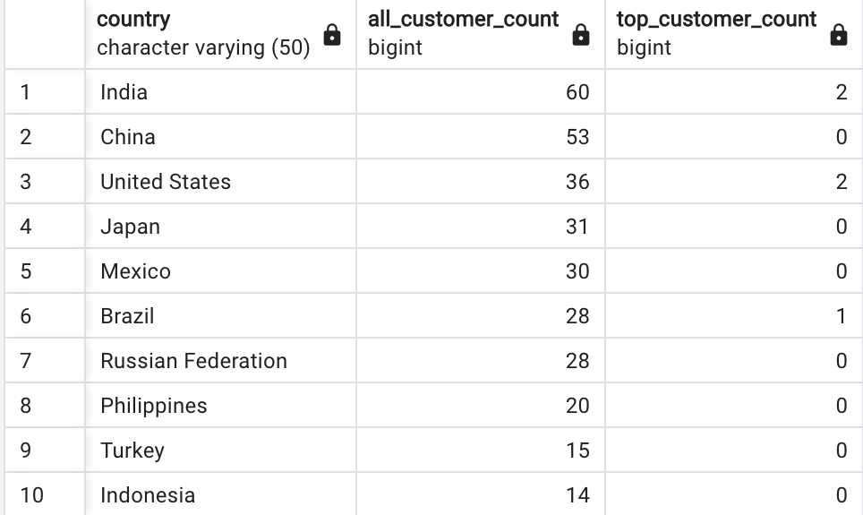
Where are the Rockbuster customers?
The top 10 countries in terms of number of customers
Rockbuster Stealth boasts a global customer base across 108 countries, with the most significant presence in India, China, the United States, Japan, Mexico, Brazil, the Russian Federation, the Philippines, Turkey, and Indonesia, highlighting its extensive international reach.

Slide 6
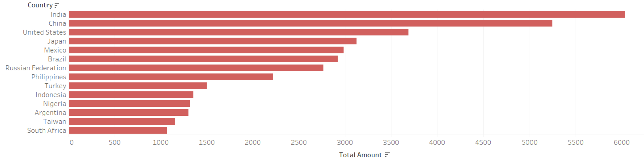
Which countries have higher revenue?
Fourteen countries report revenues surpassing $1,000. Remarkably, the top 10 customer-rich countries directly align with those generating the highest revenues, indicating a strong correlation between customer base size and financial success.

Slide 7
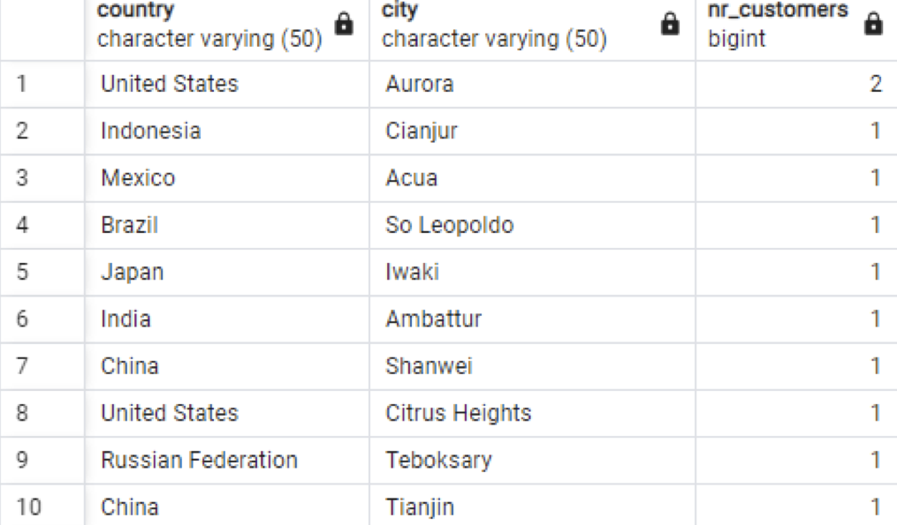
In which cities do the customers live ?
We recently saw in which country the customers were, in this case we are looking deeper and looking from which city

Slide 8
Who are the top 5 customers ?
Throughout our assessment, we have identified five exceptionally loyal customers. Their names are:
Arlene Harvey, From Ambattur, India : $ 111,76
Kyle Spurlock, From Shanwei, China : $ 109,71
Marlene Welch, From Iwaki, Japan : 106,77
Glen Talbert, From Acua, Mexico : $ 100,77
Clinton Buford, From Aurora, United States : $ 98,76

Slide 9
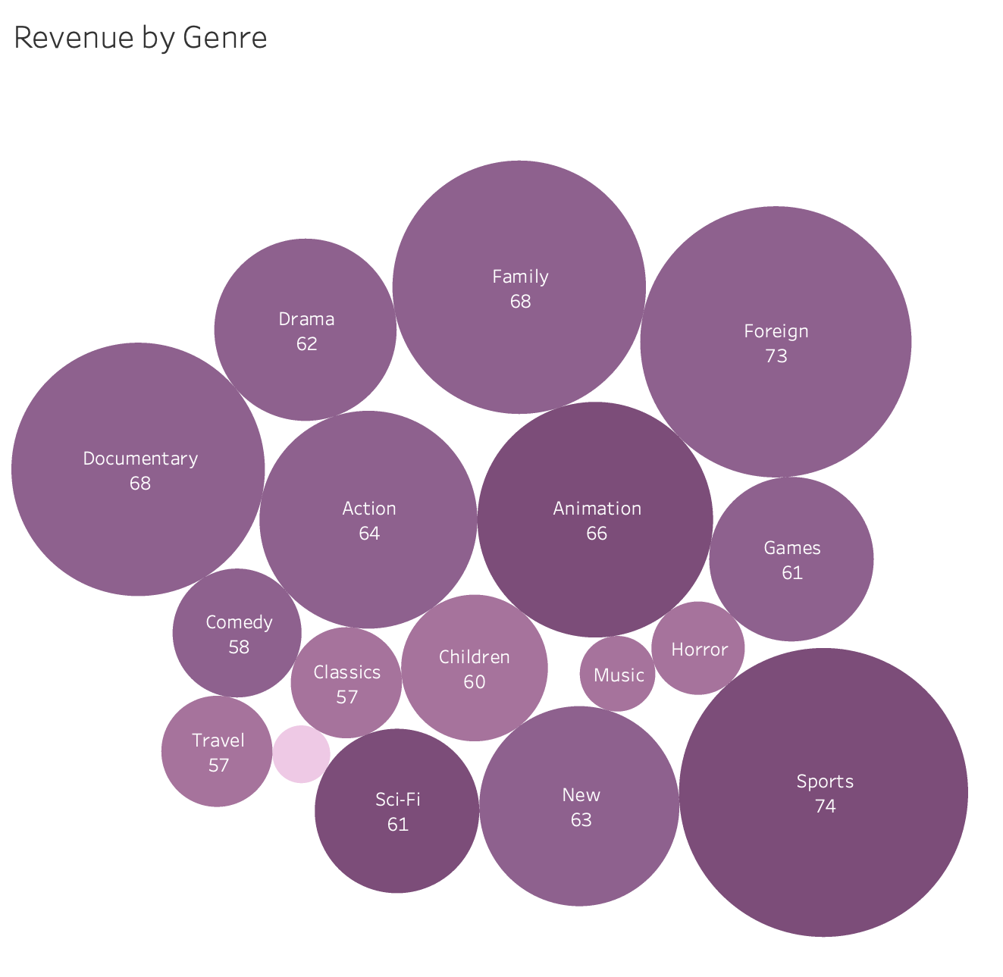
Which genres are the most representative ?
Our analysis reveals that six genres stand out for their popularity: Sports, Foreign, Family, Documentary, Animation, and Action. These categories consistently attract a wide audience, reflecting diverse interests and preferences among our customer base. Each genre brings its unique appeal, from the adrenaline-pumping excitement of Action films to the informative and enlightening nature of Documentaries. This diversity not only caters to various tastes but also underscores the broad appeal of our collection, ensuring there's something for everyone.

Slide 10
Recommendations
To enhance our service offering, I propose a multifaceted expansion strategy.
This involves broadening our film catalog across more genres and languages, alongside flexible pricing models tailored to rental durations. We aim to introduce a loyalty program to reward our most dedicated customers.
Furthermore, by partnering with our top clients to serve as Rockbuster Ambassadors, we anticipate boosting our customer base and rental frequency.
Following the rollout of these strategies, continuous data analysis and open communication will guide further adjustments and recommendations to align with evolving consumer preferences.

